Slide 1

Analysis of Twitter Data

Slide 2

Problem Statement
After a year-and-a-half long hiatus, many offices are opening up. Most companies are asking that employees return on a hybrid basis, meaning they come into the office at least some of the time. But what exactly that will look like is uncertain.
Hence, to understand people's view on whether they are comfortable with Work from home or they want to come back to offices , I considered analyzing the worldwide twitter data.
This project studied #workfromhome and #remotework related tweets to find out the opinions expressed by people.
Notes:
Even though many companies allowed their staff to work remotely before the COVID-19 pandemic hit the world, it became the new norm after that. As the pandemic spread, forcing the world to go into lockdown, business organizations were left with no other option than to switch to online working. As a result, there has been a drastic increase in the number of remote workers, lately.

Slide 3
Data
The data was collected by reading through Twitter API on from July 11,2021 to July 25,2021.Most recent and popular tweets from #workfromhome and #remotework were taken to conduct the analysis.
Total Tweets | Number Of Retweets | Actual Tweets
22054 | 7571 | 14483

Slide 4
Most Retweeted Tweets

Slide 5
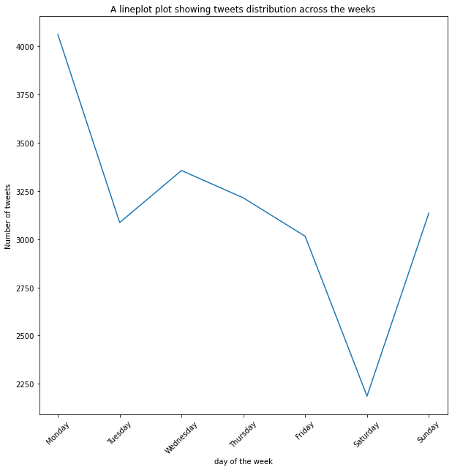
Tweets distribution on weekdays
Lowest tweeting activity on Saturday, then the frequency increases slowly up to Monday where the max is recorded

Slide 6
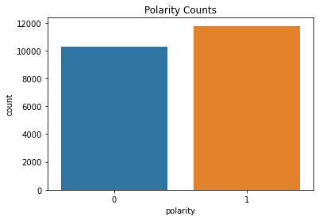
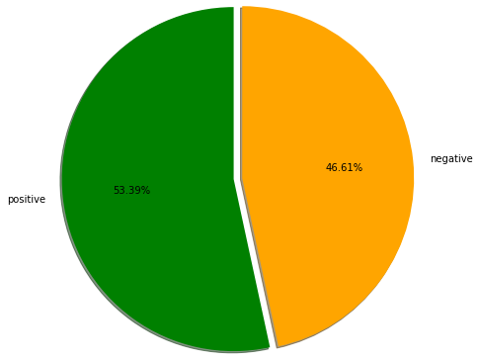
Polarity of the data
Nearly 12000 tweets are interpreted as positive whereas nearly 10000 tweets were interpreted as negative

Slide 7
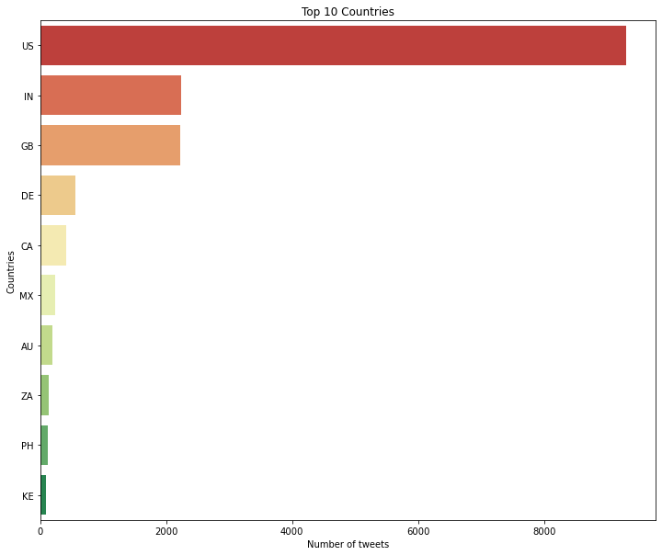
Most tweeted 10 countries
According to Sysomos research, Top 10 countries, number of Twitter users: USA, UK, Canada, Australia, Brazil, Germany, Netherlands, France, India, South Africa.

Slide 8
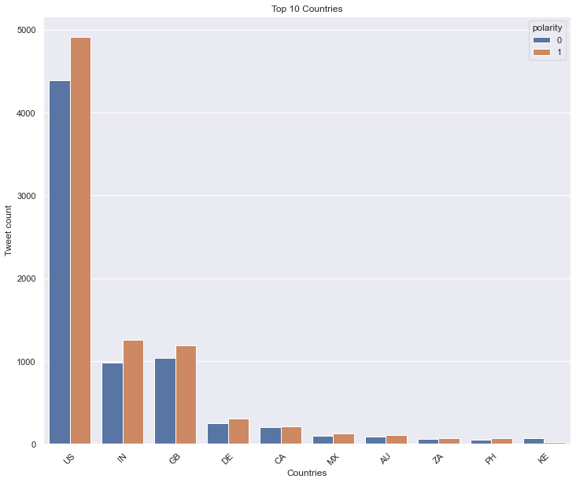
Number of positive and negative tweets in most tweeted 10 countries

Slide 9
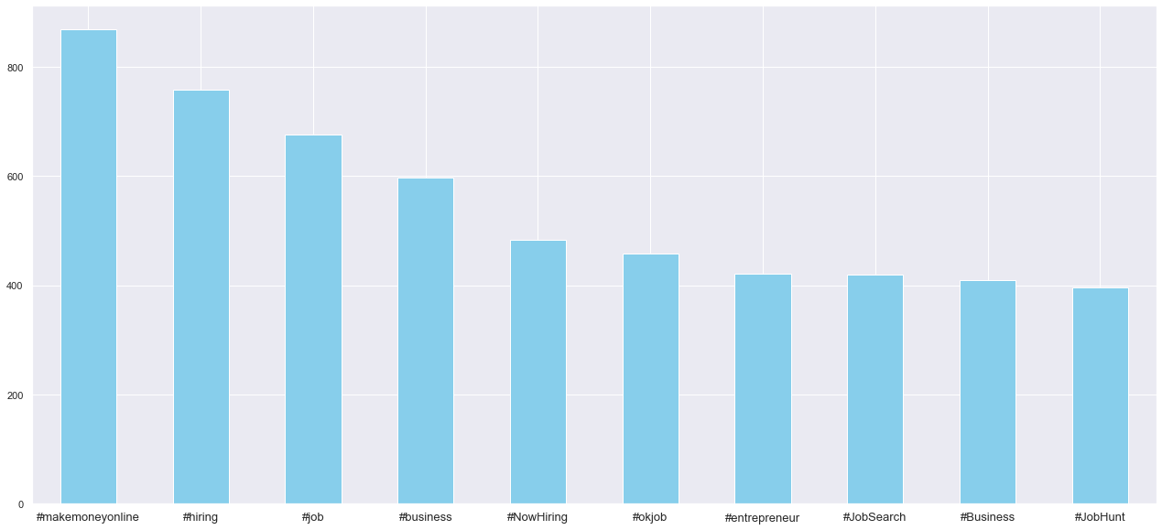
Most repetitive hashtags
Hashtags used in most of the data apart from #remotework and #workfromhome are mostly about remote jobs.

Slide 10
Most representative terms per cluster

